Slide 1
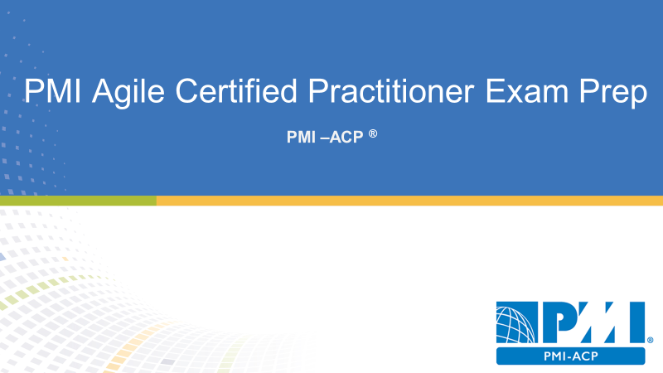
Domain VII Continuous Improvement
9 % of PMI-ACP Exam
11 Questions

Slide 2
Continuous Improvement Overview
Overview

Slide 3

Agenda
Continuous Improvement Overview
Continuous Process Improvement
Continuous Product Improvement
Continuous People Improvement

Slide 4
Continuous Improvement Tasks
Periodically review and tailor the process
Improve team processes through retrospectives
Seek product feedback via frequent demonstrations
Create an environment for continued learning
Used values dream analysis to improve processes
Spread improvements to other groups in the organization

Slide 5
Lessons Learned
Lessons learned are captured in each iteration
Allows lessons to be applied in next iterations
Lessons are repeated until they are learned

Slide 6
Continuous Improvement and Quality
Quality assurance is prevention driven
Quality assurance is planning for quality
Quality control is inspection driven
You cannot inspect quality into a product

Slide 7
Kaizen
Japanese word meaning change for the better
Small incremental steps for improvement
Plan Do Check Act
Plan, develop, evaluate learn

Slide 8
Continuous Process Improvement
Improving Process in Agile Project

Slide 9
Process Tailoring in Agile Projects
Adapting agile for your environment
There is some risk with tailoring
Better to create processes for each project as needed
Consider risk and reward

Slide 10
Risk & Reward of Process Tailoring
First embrace traditional agile processes before attempting to change
Second examine the motivation for changing processes

Slide 11
Using Hybrid Model
You can use elements from different agile models
Combinations to best fit your environment
There’s no right or wrong hybrid

Slide 12
System Thinking
Understanding the system’s level environment
Classifying projects by their level of complexity and uncertainty
Project requirements
Technical approach
Looking for a balance between simple and highly chaotic

Slide 13
Process Analysis
Reviewing and diagnosing issues with agile methods
Trying to discover what does and does not work
Often done after process tailoring

Slide 14
Looking for Antipatterns of methodologies
One-size-fits-all projects
Intolerant processes
Heavy methodologies
Embellished methodologies
Untried methodologies
Used only once

Slide 15
3 Success Criteria
The project got shipped
The leadership remained intact
The team would work the same way again

Slide 16
Methodology of success patterns
Interactive face-to-face communication is the cheapest and fastest channel for exchanging information
Excess methodology weight is costly
Larger teams need heavier methodologies
Projects with greater criticality require greater ceremony
Feedback and communication reduce the need for intermediate deliverables
Discipline skills and understanding counter process formality and documentation
Efficiency is expendable in on bottleneck activities

Slide 17
Value Stream Mapping
Lean manufacturing technique adopted by agile
A visual map of a process flow to identify delays waste and constraints

Slide 18
How to create visual stream mapping
Identify the product or service to be analyzed
Map current processes steps, queues, delays, and information flows
Review the map for delays waste and constraints
Create a new value-stream map of the desired future state for the process
Develop a road map for creating the optimized state
Plan to revisit the process in the future to continually refine and optimize

Slide 19
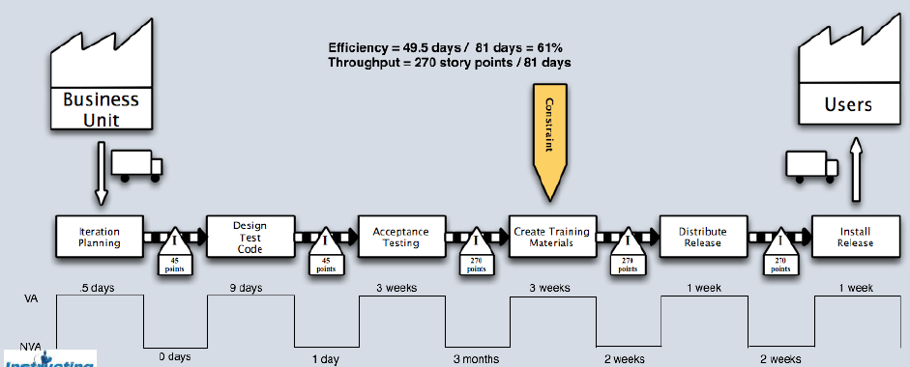
Value Stream Mapping Example

Slide 20
Project Pre-Mortem
Aims to find failure points before they happen
Imagine the failure
Generate the reason for failure
Consolidate the list
Revisit the plan

Slide 21
Continuous Product Improvement
Products are iteratively and incrementally improved

Slide 22
Product Reviews
Product feedback
Retrospective and demos

Slide 23
P D C A Cycle

Slide 24
Agile Review Rules
Let the data speak for itself
Respect individuals
Diverge and then converge

Slide 25
Product Feedback Loops & Learning Cycles
Does it meet the customers needs and expectations
Does it work and all conditions
Did we break anything while building this
How can we improve efficiency
How can quality be improved
How can we share lessons learned

Slide 26
Product Feedback Methods
Prototypes
Simulations
Demos

Slide 27
Approved Iterations
Iterations and sprint reviews
Held at the end of a sprint
Demonstrates the new incremental build
Business partner approved work
Next sprint may begin

Slide 28
Continuous People Improvement
Helping People to improve in Agile Projects

Slide 29
Retrospective for People Improvement
What is going well
What areas could use improvement
What should we be doing differently

Slide 30
Why do you need Retrospective
Improve productivity
Improved capabilities
Quality improvement
Capacity improvement

Slide 31
Setting the stage for Retrospective
Encourage participation
Set the ground rules
Define what people want from the retrospective
Have people checking in with one or two words
Ask the team to commit to focus
Explorer shopper vacationer prisoner
Working agreements for the retrospective

Slide 32
Gather data in retrospective
Used techniques to extract data
Get people involved in contributing
Facilitate the meaning for contributions

Slide 33
Methods for Gathering data in retrospective
The team creates a timeline
Triple nickels –five groups spending five minutes on 5 ideas 5 times
Color-coded dots –used color-coded dots to track your energy was high and low throughout the duration
Mad sad or glad –track emotions throughout the timeline

Slide 34
Methods for Gathering data during the duration
Satisfaction histogram –a bar chart showing satisfaction about particular areas or issues
Team radar –an assessment of performance improvement
Locates strengths -what went well, or not well, in the iteration
Like to like –compares reactions to different iteration events

Slide 35
Generating Insights
Evaluate the data
Create insights based on the data
Done with the project team

Slide 36
Brainstorming
Quiet writing
Round robin
Free for all

Slide 37
Five Whys
Cause and effect exercise
Small groups
Ask why five times
The goal is to find root cause

Slide 38
Fishbone Analysis
Also known as a cause and effect diagram
Also known as an Ishikawa diagram

Slide 39
Decide What to do?
Create an action plan
Short subjects –keep drop add
Smart goals –specific measurable attainable relevant timely
Circle of questions –each person ask a question on how to improve one of the issues in the next person of the circle answers the question
Retrospective planning game –play in the task to reach process improvement goals

Slide 40
Close the Retrospective
Plus / delta –what to do more of and what to do less of
Help hindered hypotheses –feedback on the retrospective
Return on time invested –the team discuss the benefits of the retrospective and gives a great
Appreciation –the team gives appreciation to other team members based on efforts from the last iteration

Slide 41
Team Self Assessments
Shores team self assessment scoring model
Thinking
Collaborating
Releasing
Planning
Developing

Slide 42

Domain Completion
PMI-ACP
You have successfully completed –
Continuous Improvement domain

